Slide 1
Fake News
Detection

Slide 2
Agenda
Overview
What is Fake News?
Dataset Summary
Scope of the project
Machine Learning
Architecture Analysis
Conclusion

Slide 3
Overview
With the advancement of technology, digital news is more widely exposed to users globally and contributes to the increment of spreading and disinformation online.Fake news can be found through popular platforms such as social media and the Internet. There have been multiple solutions and efforts in the detection of fake news where it even works with tools. The rate of producing digital news is large and quick, running daily at every second, thus it is challenging for machine learning to effectively detect fake news.

Slide 4
What is Fake news
Fake news or information disorder is false or misleading information presented as news.
Fake news often has the aim of damaging the reputation of a person or entity, or making money through advertising revenue.

Slide 5
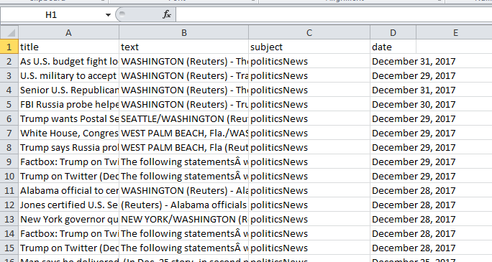
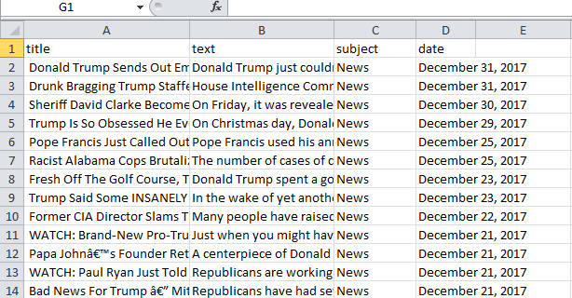
Dataset Summary
The dataset for this project likely contains text-based information from news articles.
We using the two dataset True.csv & Fake.sv
The dataset contains the title,text,subject,date.
This dataset is crucial for training machine learning models to distinguish between legitimate and fraudulent news sources.

Slide 6
Scope of the project
The project aims to use machine learning techniques for the automated identification of fraudulent news.
The scope may include developing models to analyse textual patterns, assess credibility, and flag potentially misleading information.
The primary goal is to enhance the accuracy and efficiency of identifying fraudulent news sources.

Slide 7
Machine Learning
Supervised and Unsupervised are the two types of machine learning algorithms.
Regression and Classifications analysis comes in Supervised Machine Learning.
We using Logistic Regression and Decision Tree Algorithm for predicting the fake news data.

Slide 8
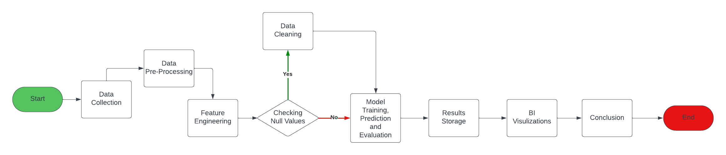
Architecture Diagram
Result Generate

Slide 9
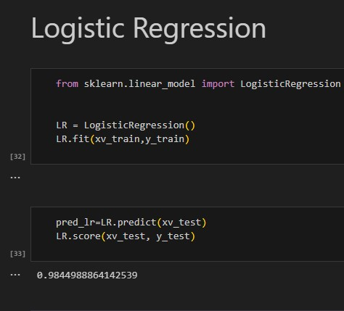
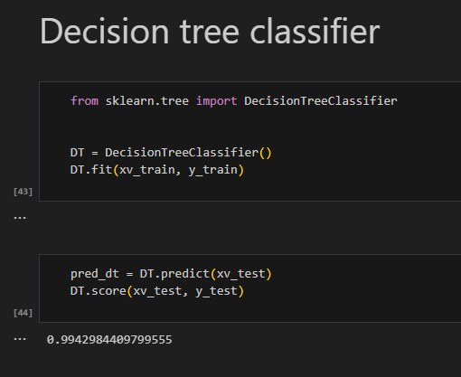
Accuracy Score

Slide 10
Conclusion
In conclusion, Fraud News Detection utilizes advanced technologies, particularly machine learning, to combat the spread of false information. By leveraging datasets containing textual information from news articles, machine learning models can effectively identify patterns associated with fraudulent content.
In this project, In the detection phase, we reviewed existing fake news detection approaches from a data mining perspective,including feature extraction and model construction.

Slide 11
Thank You

